Slide 1



AGE 214: Lecture 12
MOSFETs: Depletion & Enhancement Types
Sokoine University of Agriculture
AGE 214 - Lecture 12

Slide 2


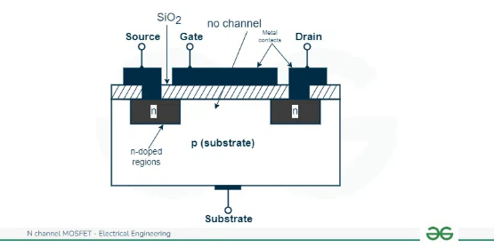
What is a MOSFET?
Definition
Metal-Oxide-Semiconductor Field-Effect Transistor.
It is the core component of modern processors (CPUs). A single chip contains billions of them.
Evolution
An upgrade to the JFET. The Gate is physically isolated from the channel.
Sokoine University of Agriculture
AGE 214 - Lecture 12

Slide 3
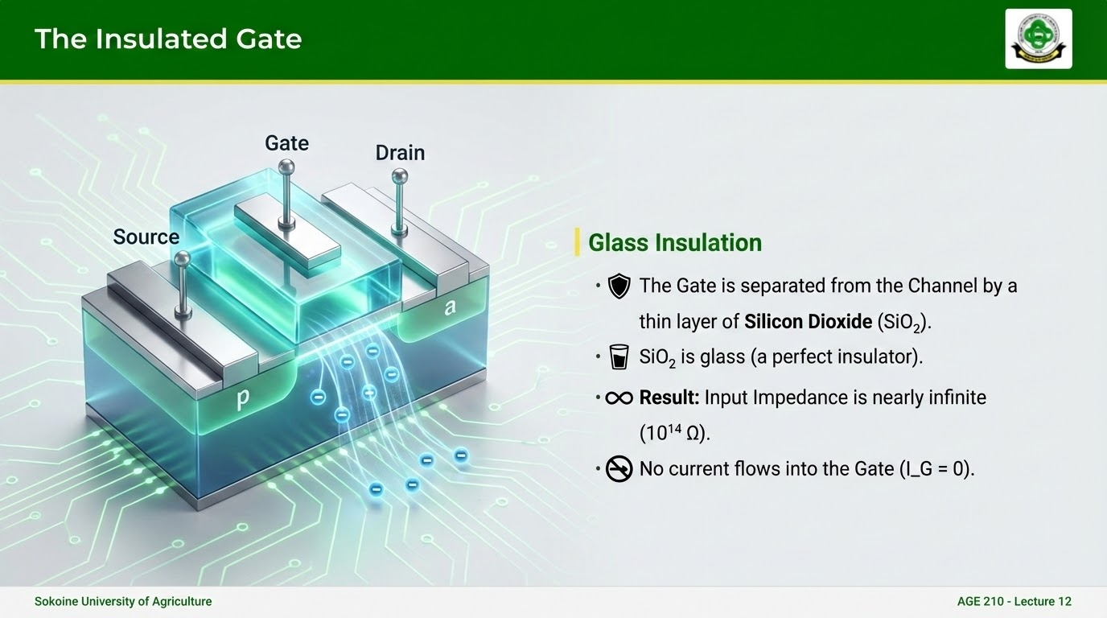

Slide 4



Types of MOSFETs
Depletion Type
Enhancement Type
(D-MOSFET)
(E-MOSFET)
Normally ON. A physical channel exists between Source and Drain.
Normally OFF. No physical channel exists. You must induce one.
Both types have N-Channel and P-Channel versions.
Sokoine University of Agriculture
AGE 214 - Lecture 12

Slide 5
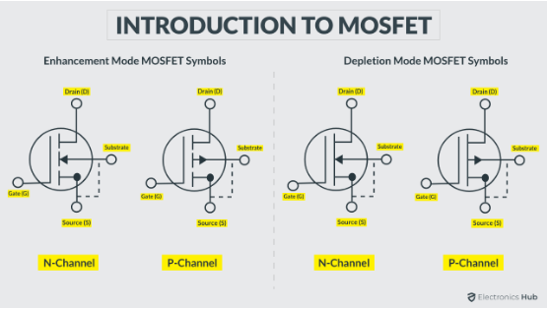
D-MOSFET Construction
Structure
•
A physical N-channel connects Source and Drain.
•
Can operate in two modes:
○
Depletion Mode: Negative $V_{GS}$ pushes electrons away, narrowing channel.
○
Enhancement Mode: Positive $V_{GS}$ attracts electrons, widening channel.
Sokoine University of Agriculture
AGE 214 - Lecture 12

Slide 6
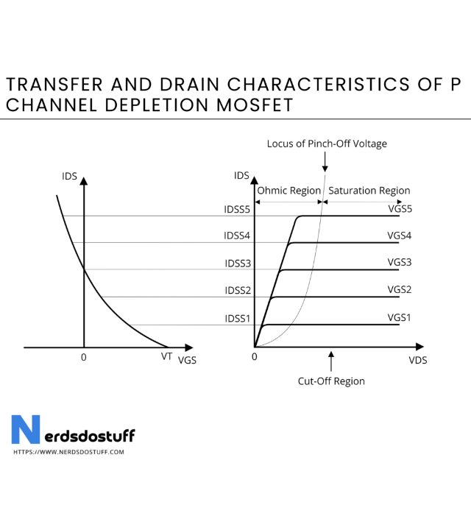
Characteristic Curves
Unlike JFETs (which must stay negative), D-MOSFETs can handle positive Gate voltages.
•
V_{GS} = 0$: I_{D} = I_{DSS}
•
V_{GS} < 0$: Current reduces (Depletion).
•
V_{GS} > 0$: Current increases above I_{DSS} (Enhancement).

Slide 7

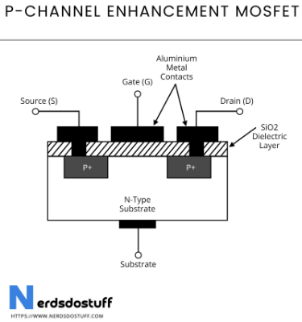
E-MOSFET Construction
Normally OFF Device
•
No Physical Channel: The Source and Drain are separated by the P-substrate.
•
If V_{GS} = 0, the resistance is infinite. No current flows.
•
This is ideal for digital switching (Logic 0 = OFF).
Sokoine University of Agriculture
AGE 214 - Lecture 12

Slide 8

Creating the Channel
Induction
1.
Apply Positive Voltage to Gate.
2.
The positive plate repels holes and attracts Electrons (minority carriers) from the P-substrate.
3.
These electrons accumulate near the oxide layer.
4.
They form a temporary N-Channel (Inversion Layer), allowing current to flow.
Sokoine University of Agriculture
AGE 214 - Lecture 12

Slide 9



Threshold Voltage ($V_T$)
The Requirement
The Equation
The channel doesn't form instantly.
We need a minimum Gate voltage called Threshold Voltage ($V_T$ or $V_{GS(th)}$).
Current flows only when V_{GS} > V_{T}
Sokoine University of Agriculture
AGE 214 - Lecture 12

Slide 10

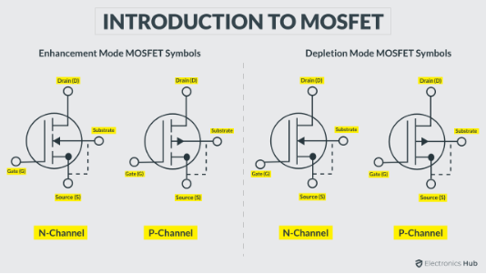
Comparing Symbols
E-MOSFET
D-MOSFET
Broken Line: Represents the broken channel (Normally OFF).
Solid Line: Represents the continuous physical channel.
Sokoine University of Agriculture
AGE 214 - Lecture 12

Slide 11
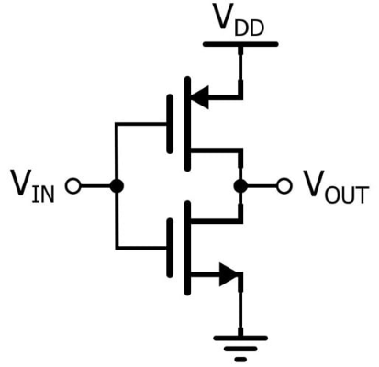
CMOS Technology
Complementary MOS
•
Combines N-MOS and P-MOS transistors.
•
Key Feature: One is always OFF when the other is ON.
•
Benefit: Extremely low power consumption (current flows only during switching).
•
This is why your phone battery lasts all day!
Sokoine University of Agriculture
AGE 214 - Lecture 12

Slide 12
Questions?
Next Lecture: Operational Amplifiers
Dr. Kadeghe Fue
Sokoine University of Agriculture
AGE 214 - Lecture 12

Slide 13






Image Sources
https://www.sua.ac.tz/themes/custom/suaweb/logo.svg
Source: www.sua.ac.tz
https://media.geeksforgeeks.org/wp-content/uploads/20240212125707/image-170.webp
Source: www.geeksforgeeks.org
https://www.olukey.com/uploads/Introduction-to-MOSFET-Featured.png
Source: www.olukey.com
https://nerdsdostuff.com/wp-content/uploads/2024/02/Transfer-and-Drain-Characteristics-of-P-Channel-Depletion-MOSFET-1024x844.png
Source: nerdsdostuff.com
https://nerdsdostuff.com/wp-content/uploads/2024/02/P-Channel-Enhancement-MOSFET.png
Source: nerdsdostuff.com
https://www.allaboutcircuits.com/uploads/articles/Keim_5_15_2024_Figure_1.jpg
Source: allaboutcircuits.com

